Slide 1

Human Live Pose Estimation Using PifPaf
Professor:
Student:
Assistant:
Alexandre Alahi
Jonathan Kaeser
Sven Kreiss
June 2019
Visual Intelligence for Transportation VITA : https://www.epfl.ch/labs/vita/

Slide 2
https://www.epfl.ch/labs/vita/

Slide 3
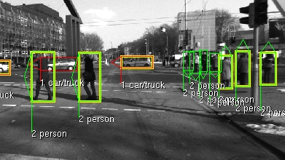
http://www.cvlibs.net/datasets/karlsruhe_objects/

Slide 4

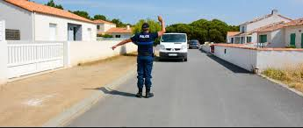




Slide 5
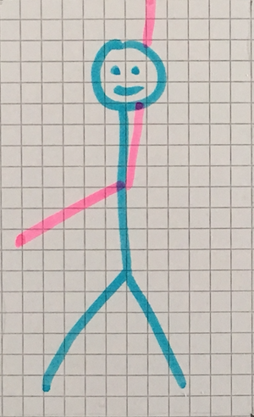
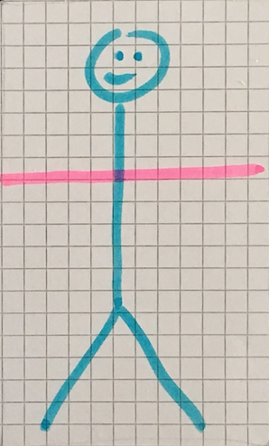
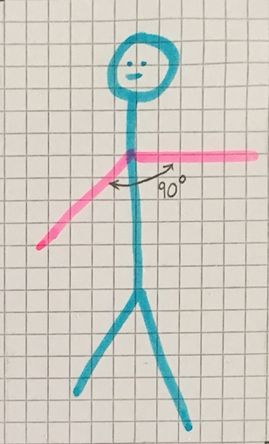
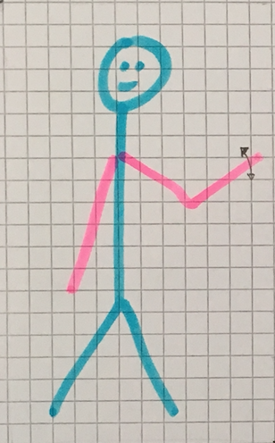
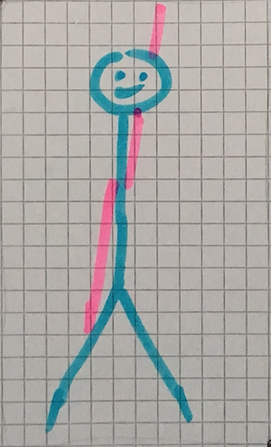

Slide 6
https://www.epfl.ch/labs/vita/

Slide 7
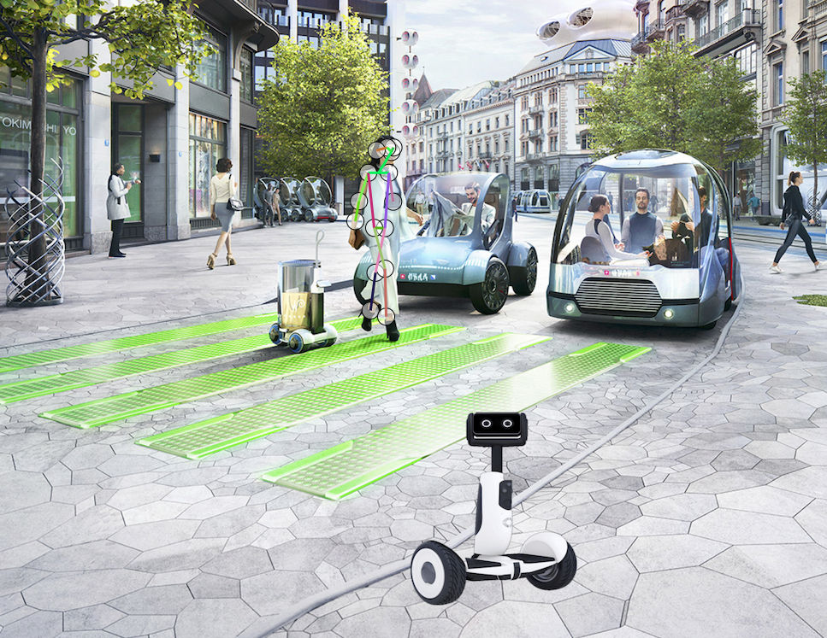
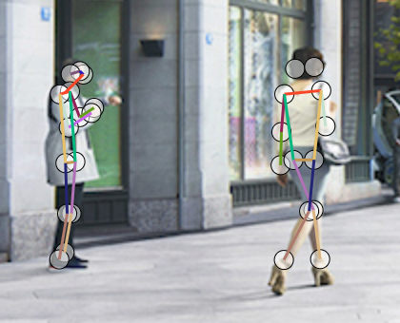
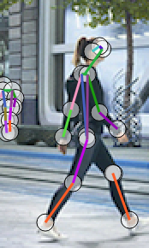
Use the PifPaf algorithm… (https://www.epfl.ch/labs/vita/research/perception/pifpaf/)

Slide 8
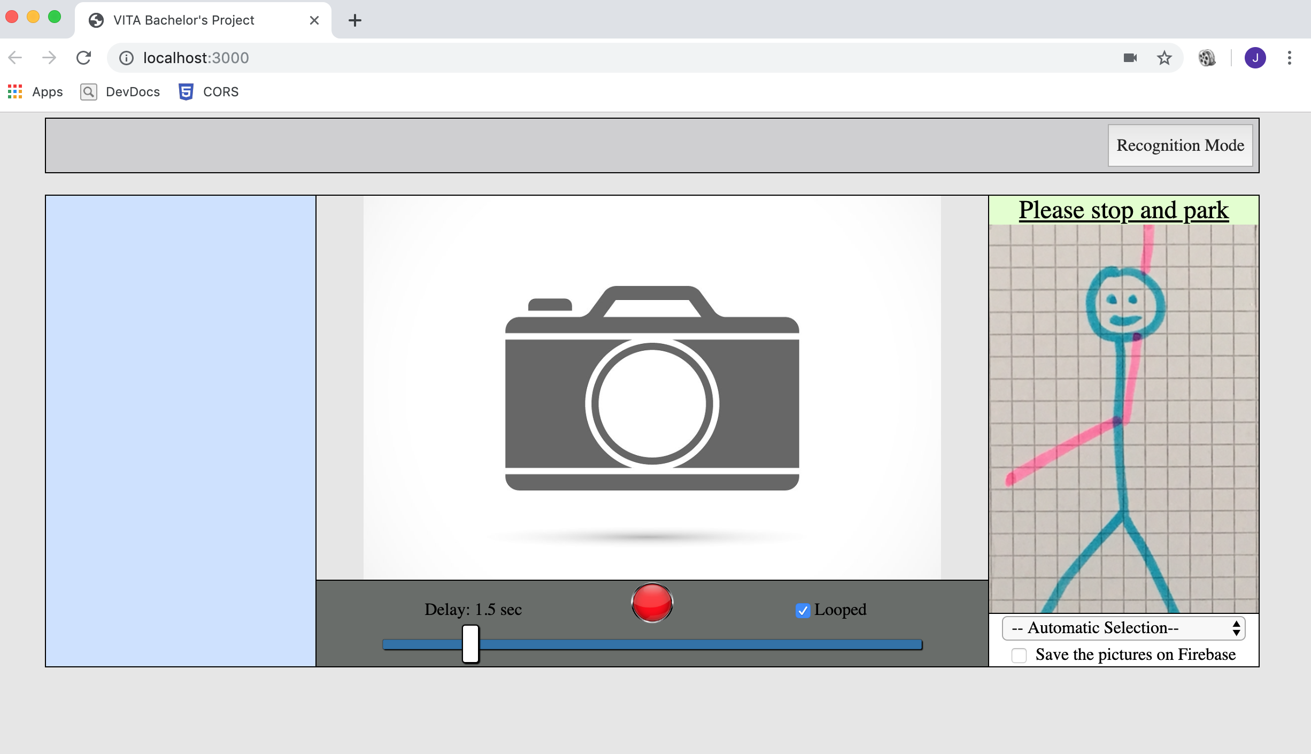
Use the PifPaf algorithm…
…in combination with a new interface…

Slide 9
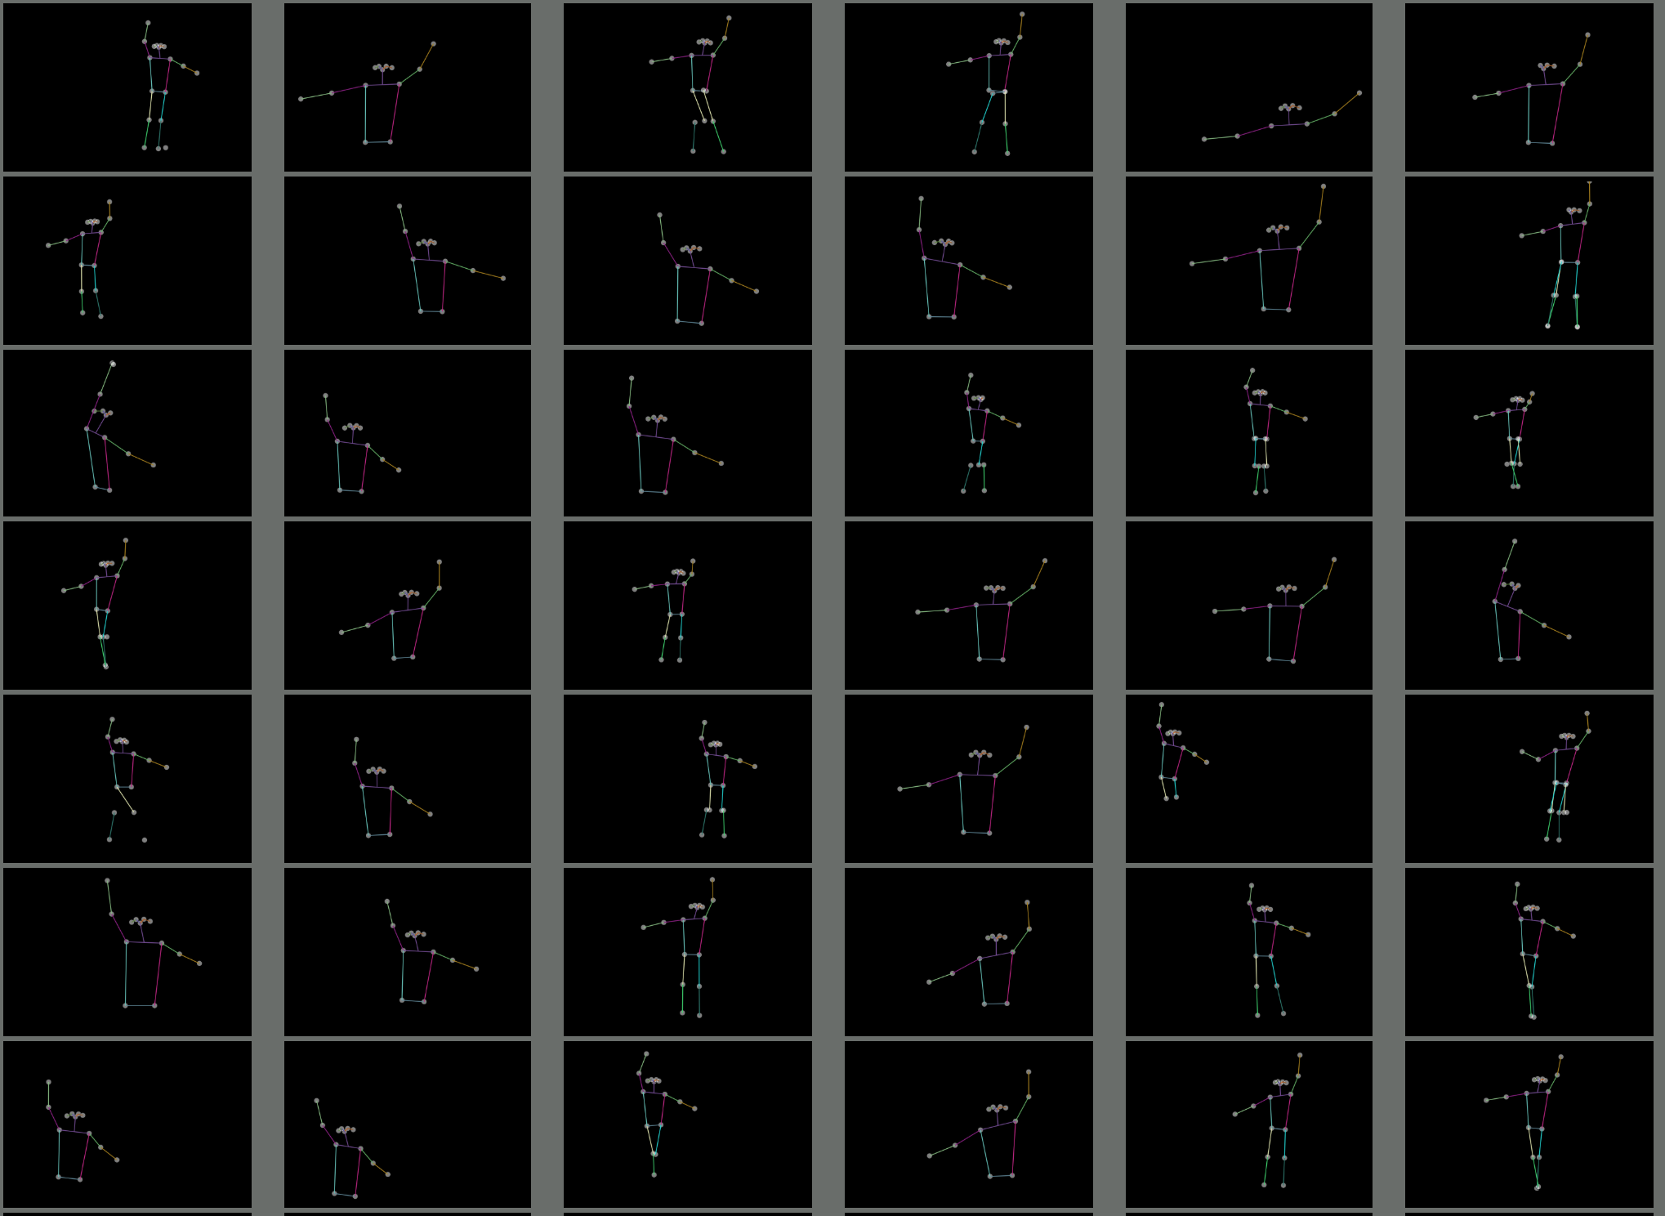
Use the PifPaf algorithm…
…in combination with a new interface…
… to get a training set …

Slide 10
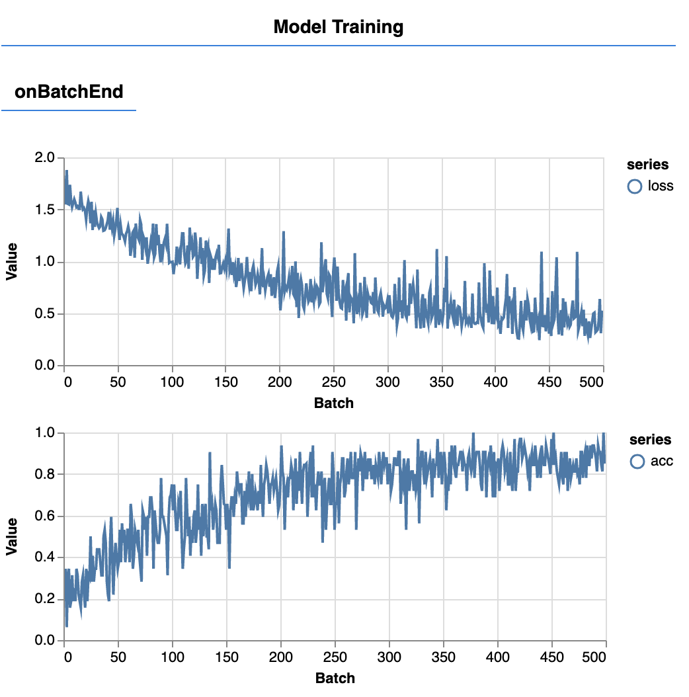
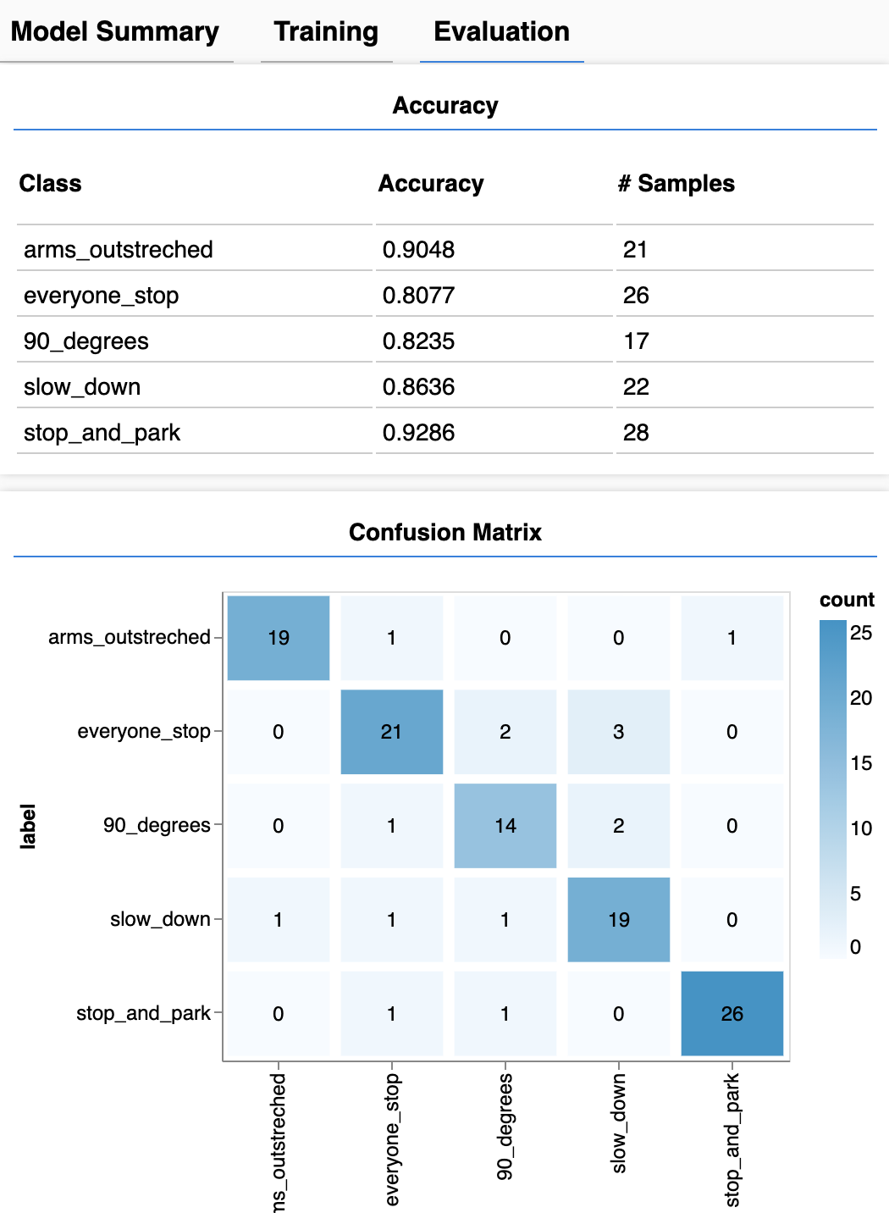
Use the PifPaf algorithm…
…in combination with a new interface…
… to get a training set .
Then train a neural network on top of it
…and finally integrate the result in the interface

Slide 11
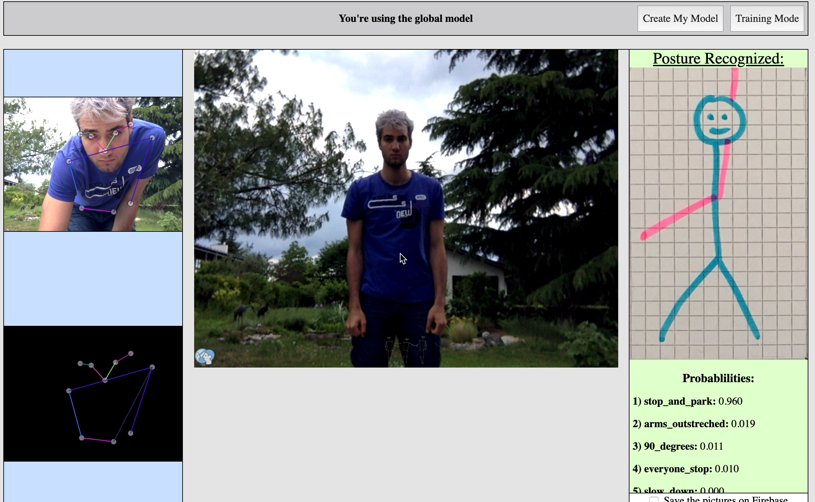
Use the PifPaf algorithm…
…in combination with a new interface…
… to get a training set .
Then train a neural network on top of it
…and finally integrate the result in the interface

Slide 12
The readme title,fond d écrant read me sur githb, avec lien en bas de la page

Slide 13


That’s great !!!

Slide 14
But how did I do it ?
That’s great !!!

Slide 15
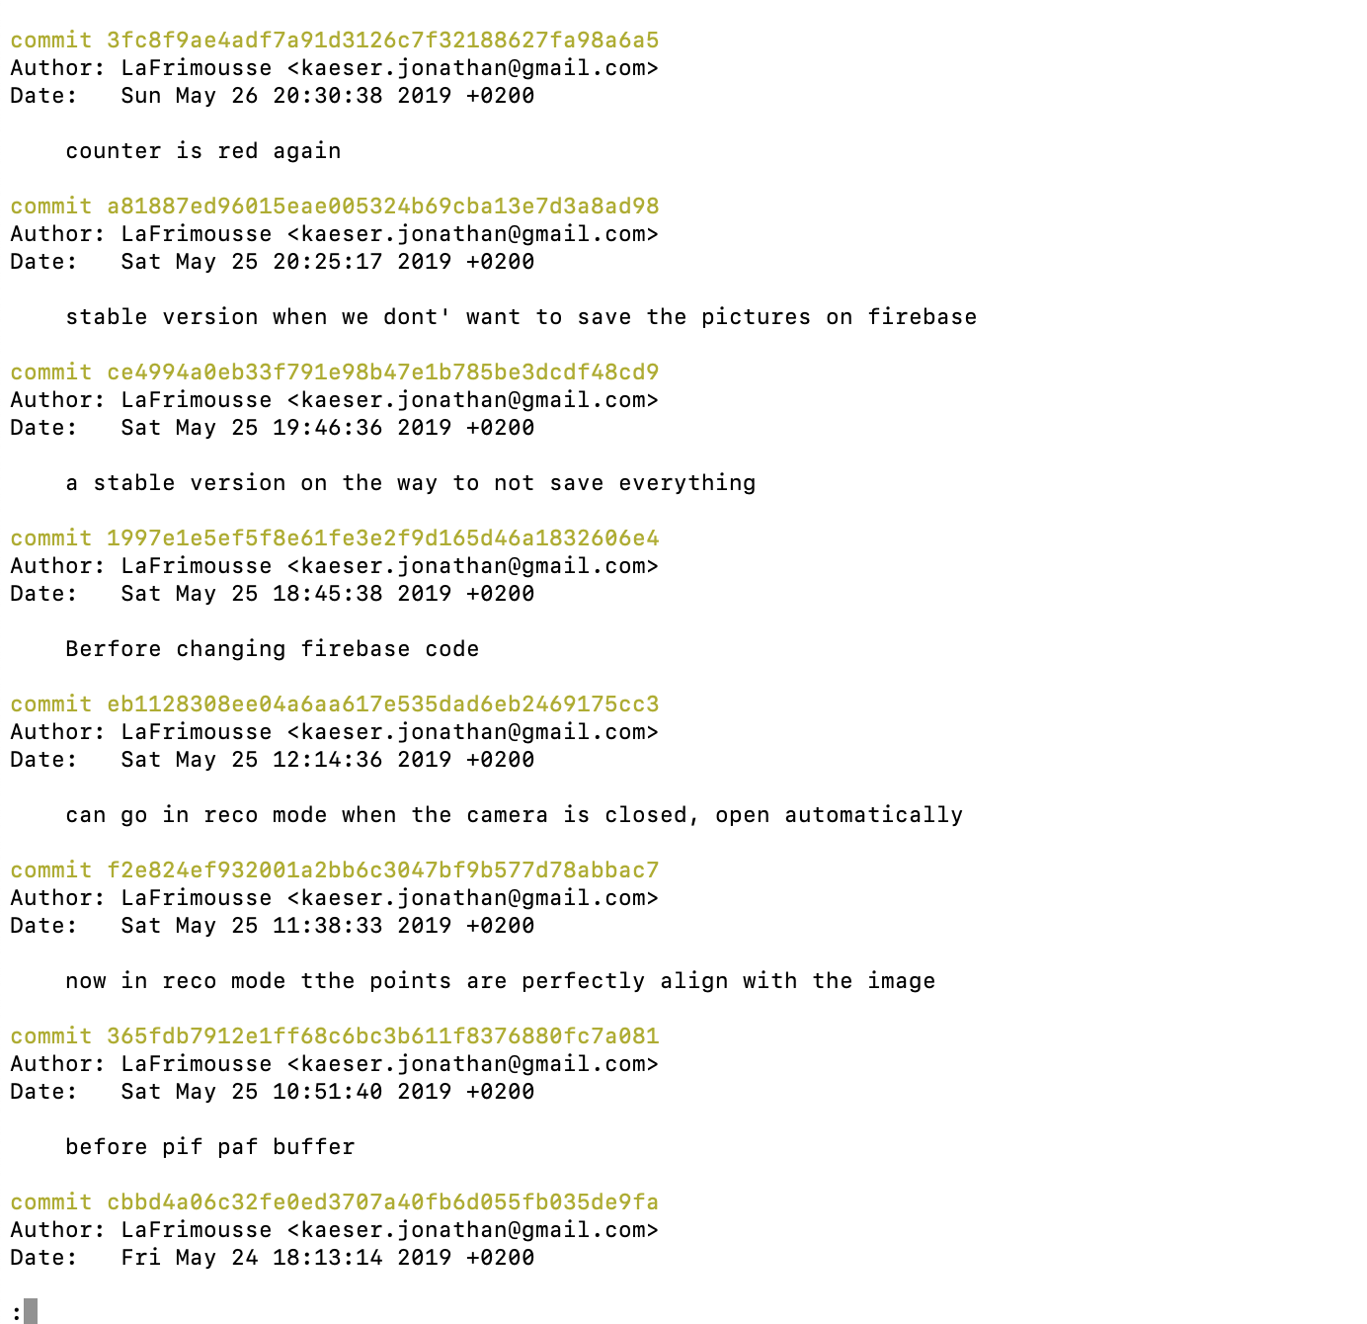
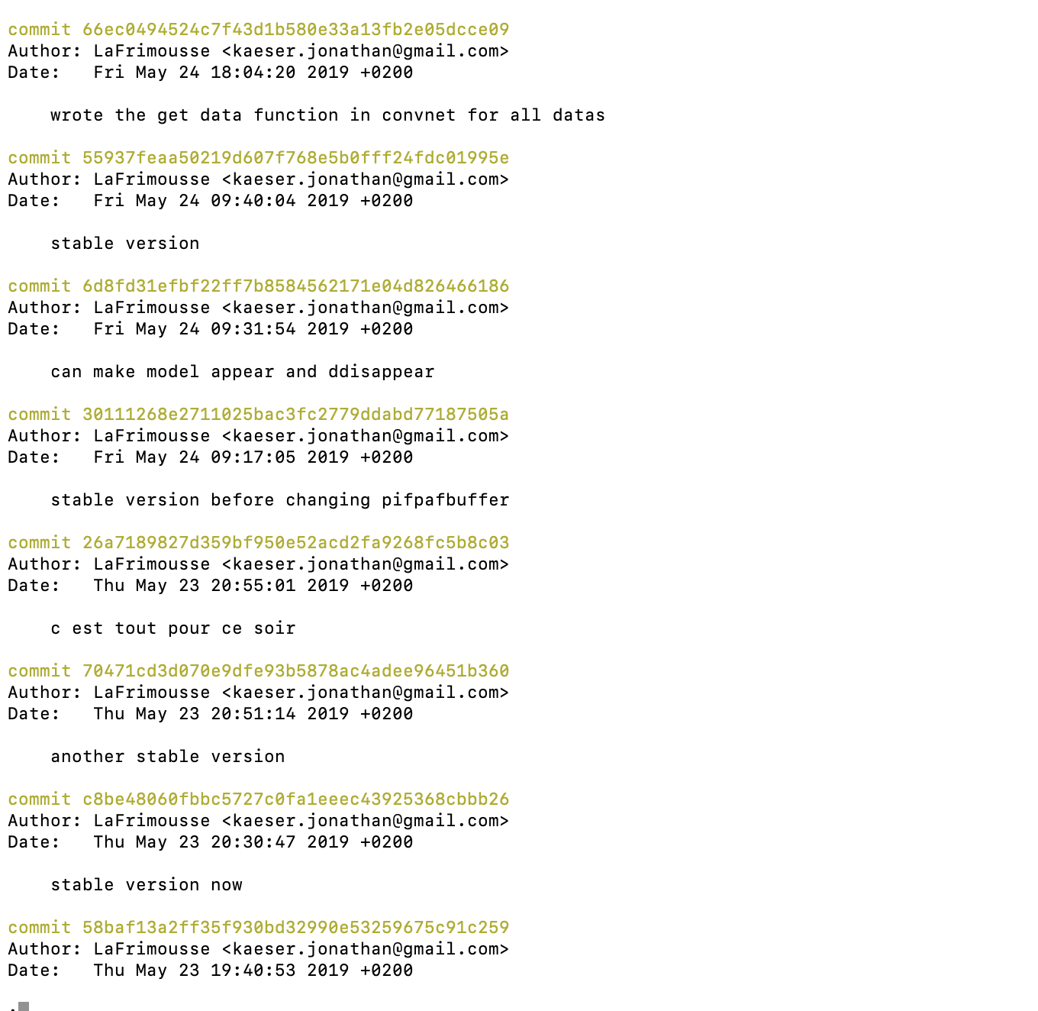
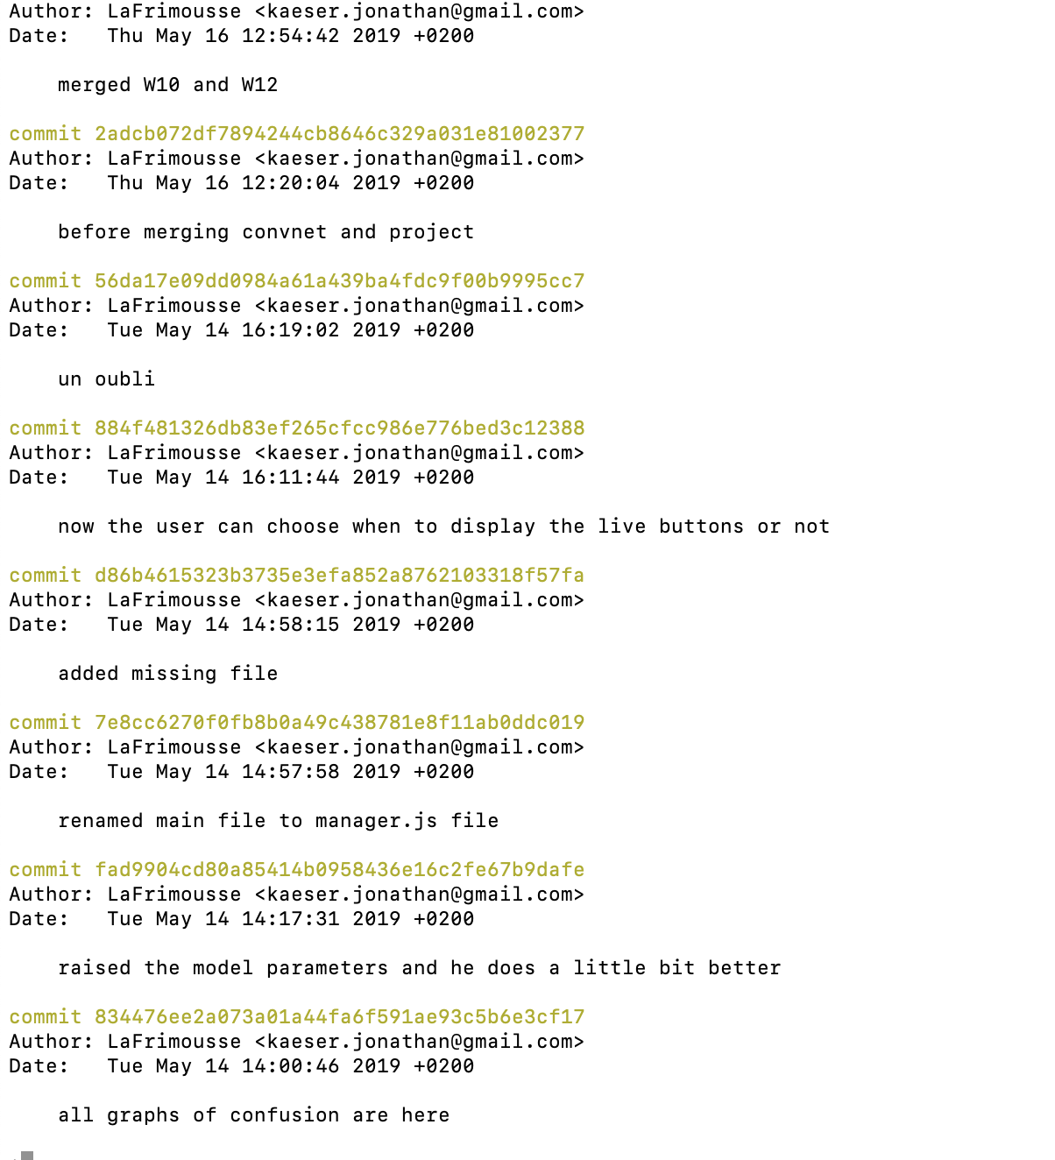
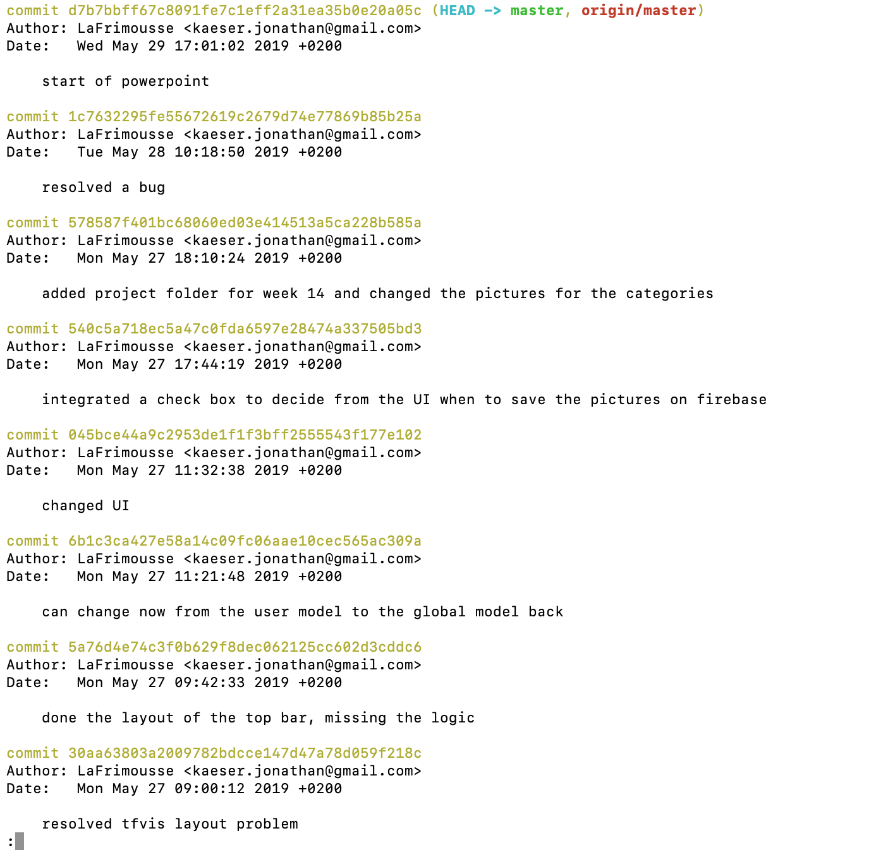
Well, it’s a long series of commit.

Slide 16
Well, it’s a long series of commit.

Slide 17
And all I had at the beginning was some…
… skils

Slide 18
And all I had at the beginning was some…
… skils

Slide 19
And all I had at the beginning was some…
… skils

Slide 20
And all I had at the beginning was some…
… skills

Slide 21
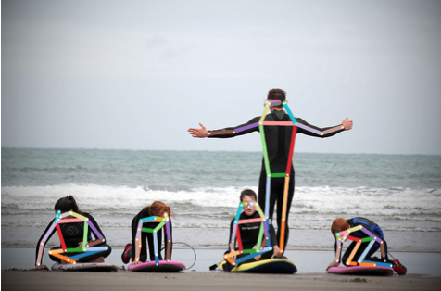
And for sure access to the PifPaf source code available on GitHub

Slide 22
Ready for the long story ? Because here we go (prévoir des notes à coté)

